Slide 1
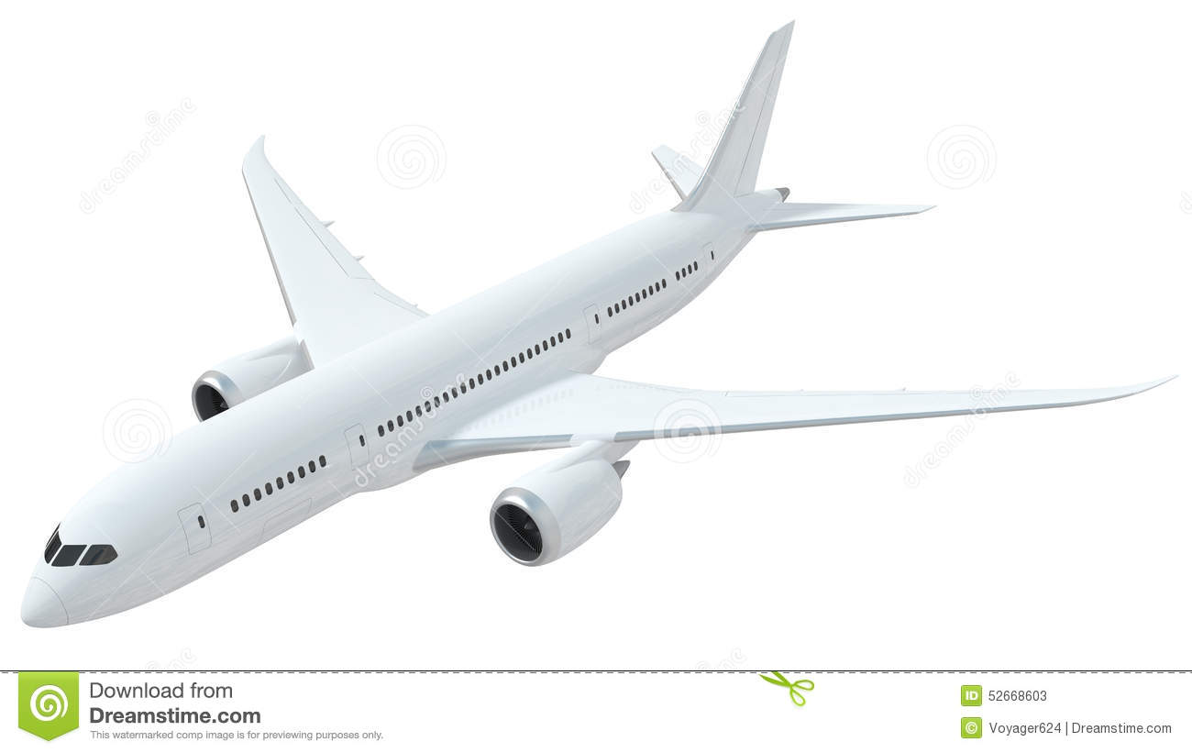

SHAHEEN AIRLINE
GROUP MEMBERS
HARIS ANWER
HIFSA BASHARAT

Slide 2
ORGANIZATION OVERVIEW

Slide 3
Shaheen Air International Limited (SAI) is established as a public limited company under the Companies Ordinance, 1984.It is mandated to carry on business of air transportation of passenger and cargo. It commenced its operations as the first Pakistani private airline in December, 1993. The airline was founded by Khalid Mehmood Sehbai, who was the airline's first chairman. The airline is named after the Shaheen falcon, Pakistan's national bird.
VISION
To spread wings across the region with innovative, principled and responsible brand of passion
MISSION
To be a force for good through value creation, providing a cost-effective and secure air travel option that sustainably connects and enriches our world

Slide 4
DESTINATIONS

Slide 5
DOMESTIC:
KARACHI
LAHORE
ISLAMABAD
PESHAWAR
MULTAN
SIALKOT

Slide 6
INTERNATIONAL ROUTES

Slide 7
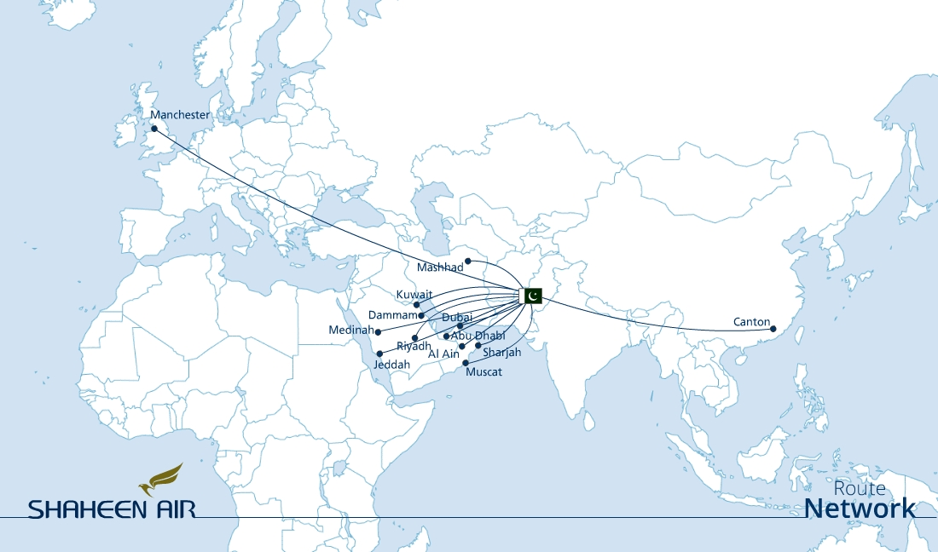

Slide 8
HIERARCHY CHART

Slide 9
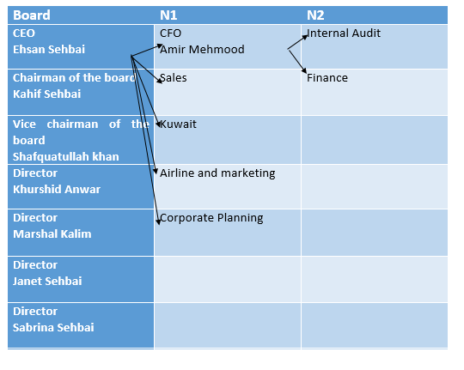
In Shaheen Airline there is Top down Hierarchy.
TOP
MANAGEMENT
MIDDLE MANAGEMNT
LOWER MANAGEMENT

Slide 10
BUSINESS FUNCTIONS

Slide 11
HUMAN
RESOURCE
MARKETING
MANUFACTURING
FINANCE
SALES

Slide 12
IT DEPARTMENT

Slide 13
IT
CUSTOMER
FOCUS
CROWD
SOURCING
EVOLVING CREATIVITY
INCREMENTAL
STEPS

Slide 14
OBJECTIVE

Slide 15
The objective is to increase growth, revenue, attract customers, and retain them.
As per management objective the objective of Shaheen airline is to serve a nation and provide best facilities to customers/passengers.

Slide 16
SYSTEMS

Slide 17
CRM
Customer relation management
MES
Management engineering system
FMS
Flight management system
PMS
Passenger management system
ERP
Enterprise resource allocation
EMS
Emergency management system
HMS
Health management system
SMA
Shaheen air mobile app
TMS
Traffic management system

Slide 18
TECHNOLOGIES

Slide 19
Shaheen airline is using following techniques for different purposes:
Data mining
Virtualizing technique
Data masking
Clustering
MPLS technique
Bulk emails
Reporting system
Dashboards
WhatsApp

Slide 20
REVENUE REPORT

Slide 21
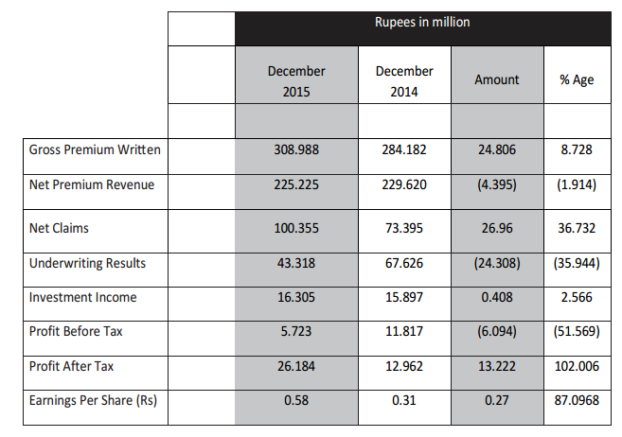

Slide 22
ABOUT BUSINESS

Slide 23
TYPE OF BUSINESS:
BUSINESS TO CUSTOMER (B2B)
RELATION
1 TO 1
1 TO MANY (If customer conveys message that flight was safe to other people)
MAJOR BUSINESS
Aviation
OTHER BUSINESS:
It includes engineering

Slide 24
SPECIALITY TO ATTRACT CUSTOMERS

Slide 25
PASSENGER REPORT

Slide 26
From 2013 the number of passengers are tend on increasing.

Slide 27
WEAKNESS OF SYSTEMS

Slide 28
There is no failure in IS system of Shaheen Airline. It is working properly actually behind the crashing planes lack of civil authority is responsible.

Slide 29
AIRPORT TECHNOLOGIES

Slide 30
Large screen( to provide info to customers for flight landing and departure time)
RFID( for security purposes)
Online ticketing
ATM
WIFI
MIS

Slide 31
FUTURE PLANS

Slide 32
INFRASTRUCTOR AND BUILDINGS
Going to shift there whole IT department in new building in 2 to 3 months where they implement their own data centre.
EXPANDING SCOPE OF:
Road Transportation
Wind Power Generation
Real Estate Development
Information Technology
Skype for business

Slide 33
CONCLUSION

Slide 34
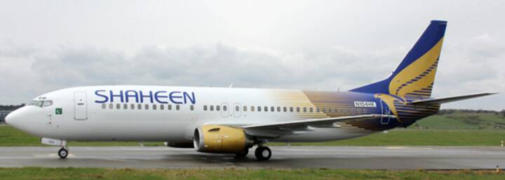
Information system is the backbone of Shaheen airline. By using IS systems they retain customers, using techniques to gather data, to take decisions. There is the need of assets like planes because number of passengers are tend on increasing day by day. They are on the way to achieve their goals but the regulatory authorities like civil authority is not working properly as they are not providing assets, not implementing new rules which is the need of time. To increase growth they should to start other businesses and revenue models.

Slide 35
THANKYOU…!

